Slide 1
Premier League Database
Submitted to –
Dr. RadhaKrishna Rambola
Submitted by –
Akshit Naithani (B208)
Vrishin Jain (B235)
Vansh Mistry (B223)
Meet Desai (B238)

Slide 2
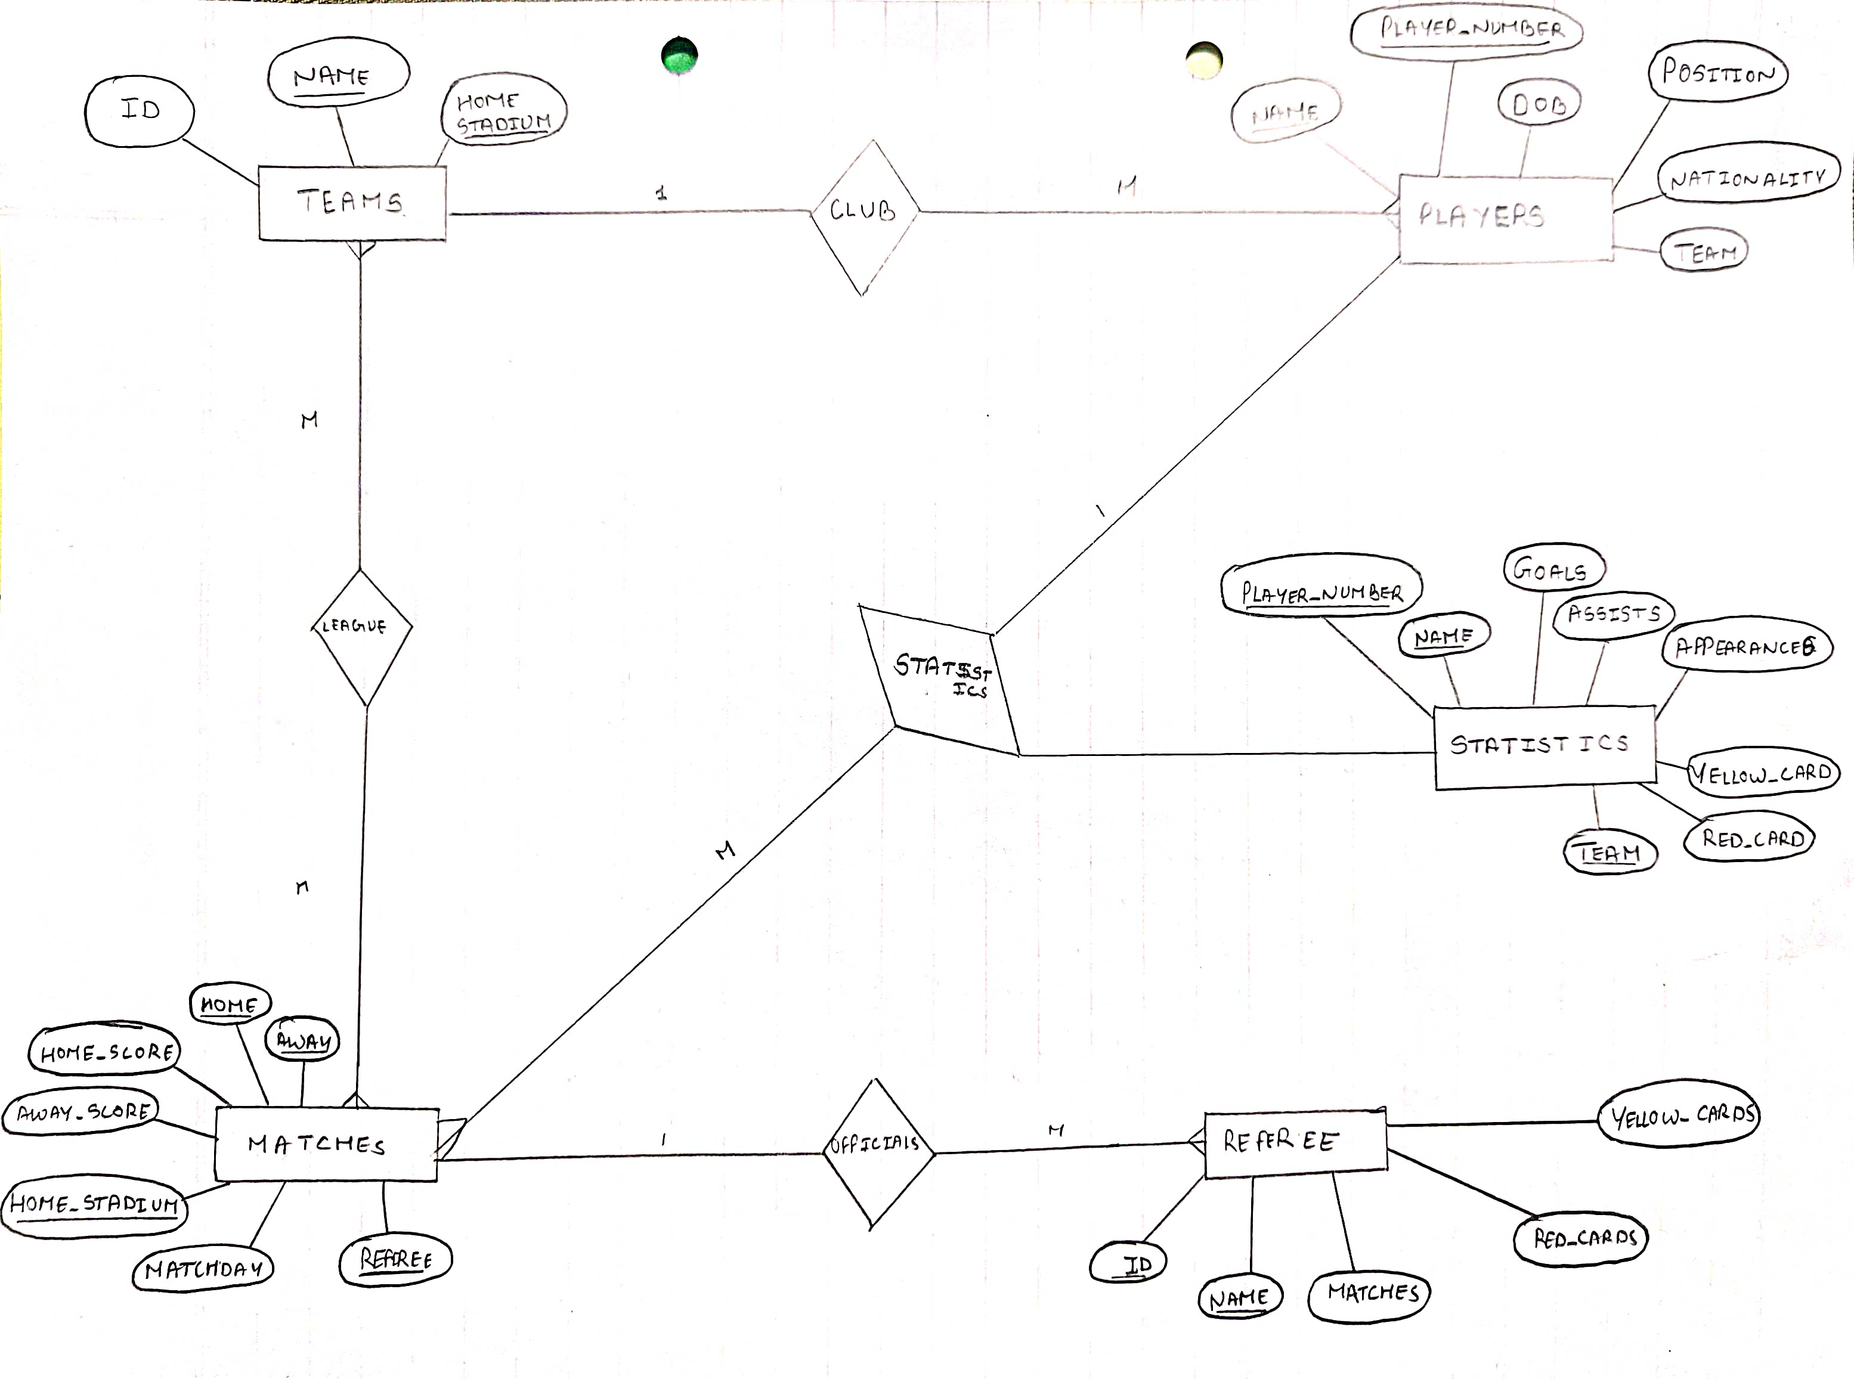
ER Diagram

Slide 3
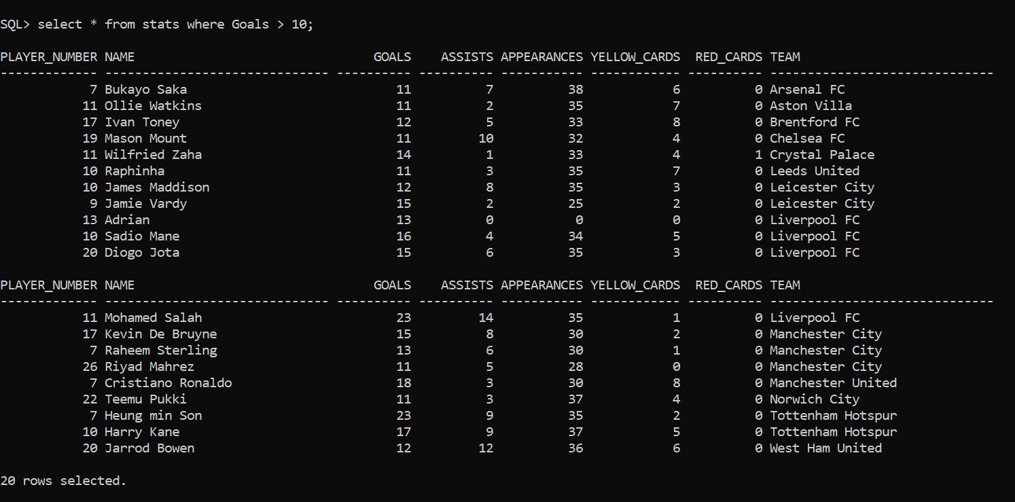
Players With Goals Greater Than 10

Slide 4
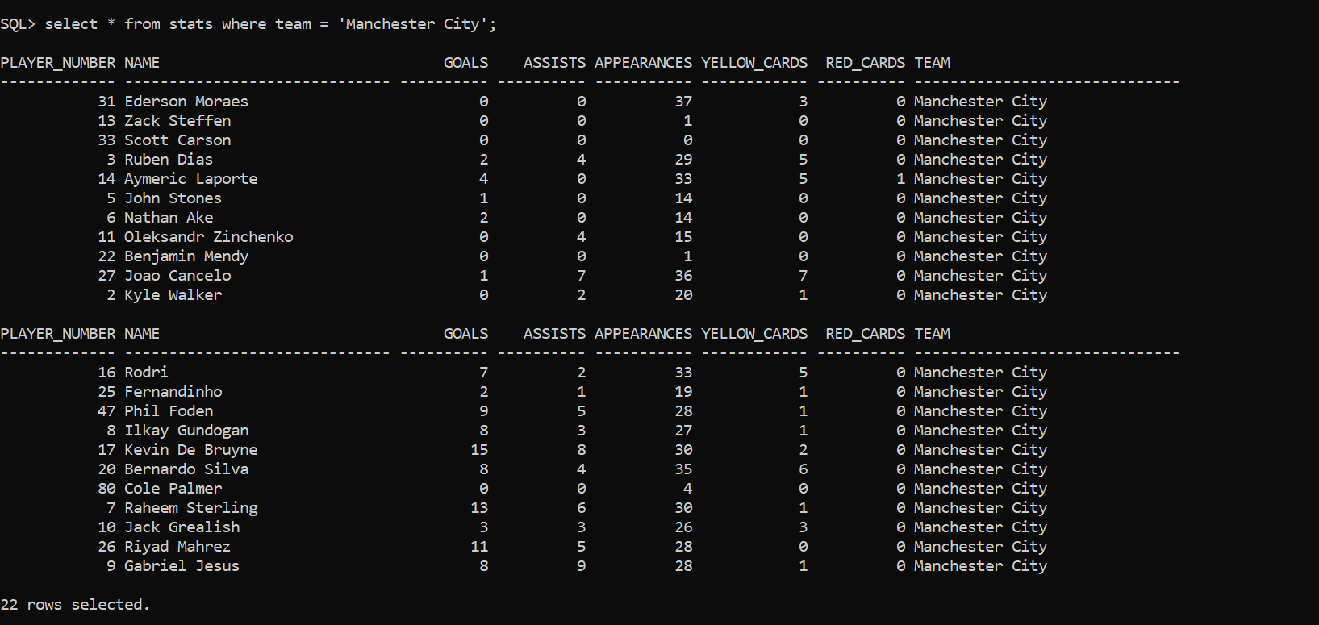
Stats Of Players From A Specific Team

Slide 5
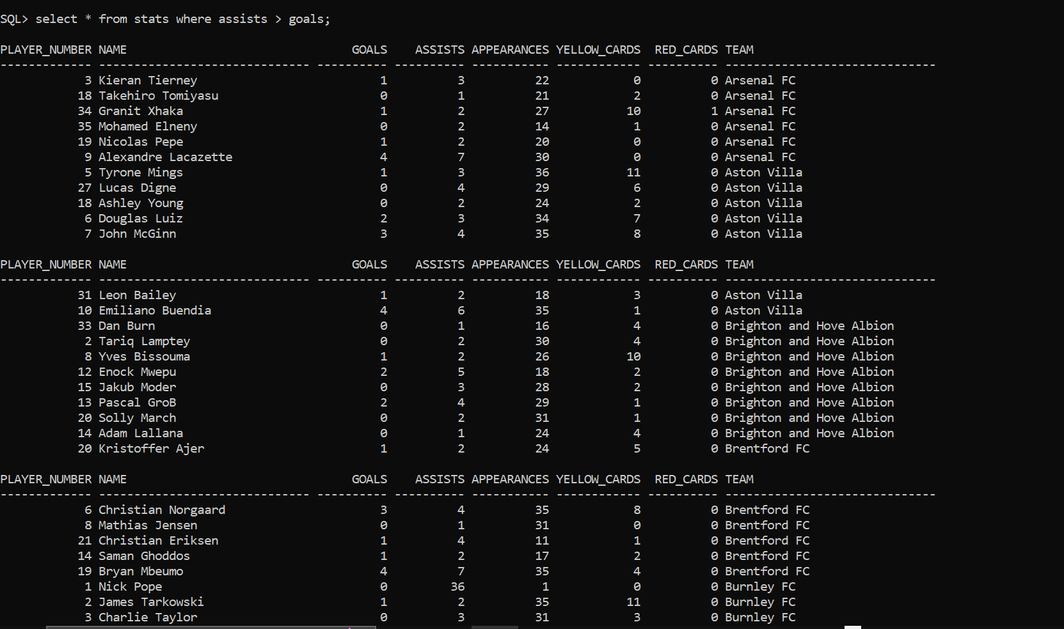
Players Who Have More Assists than Goals

Slide 6
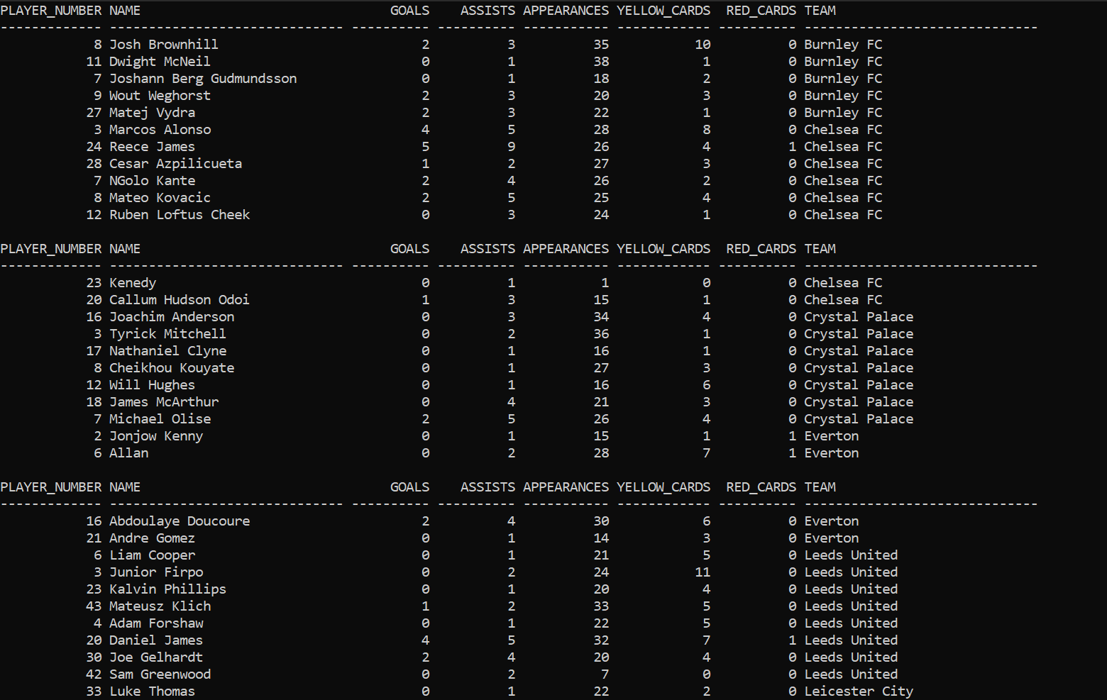
Players Who Have More Assists than Goals

Slide 7
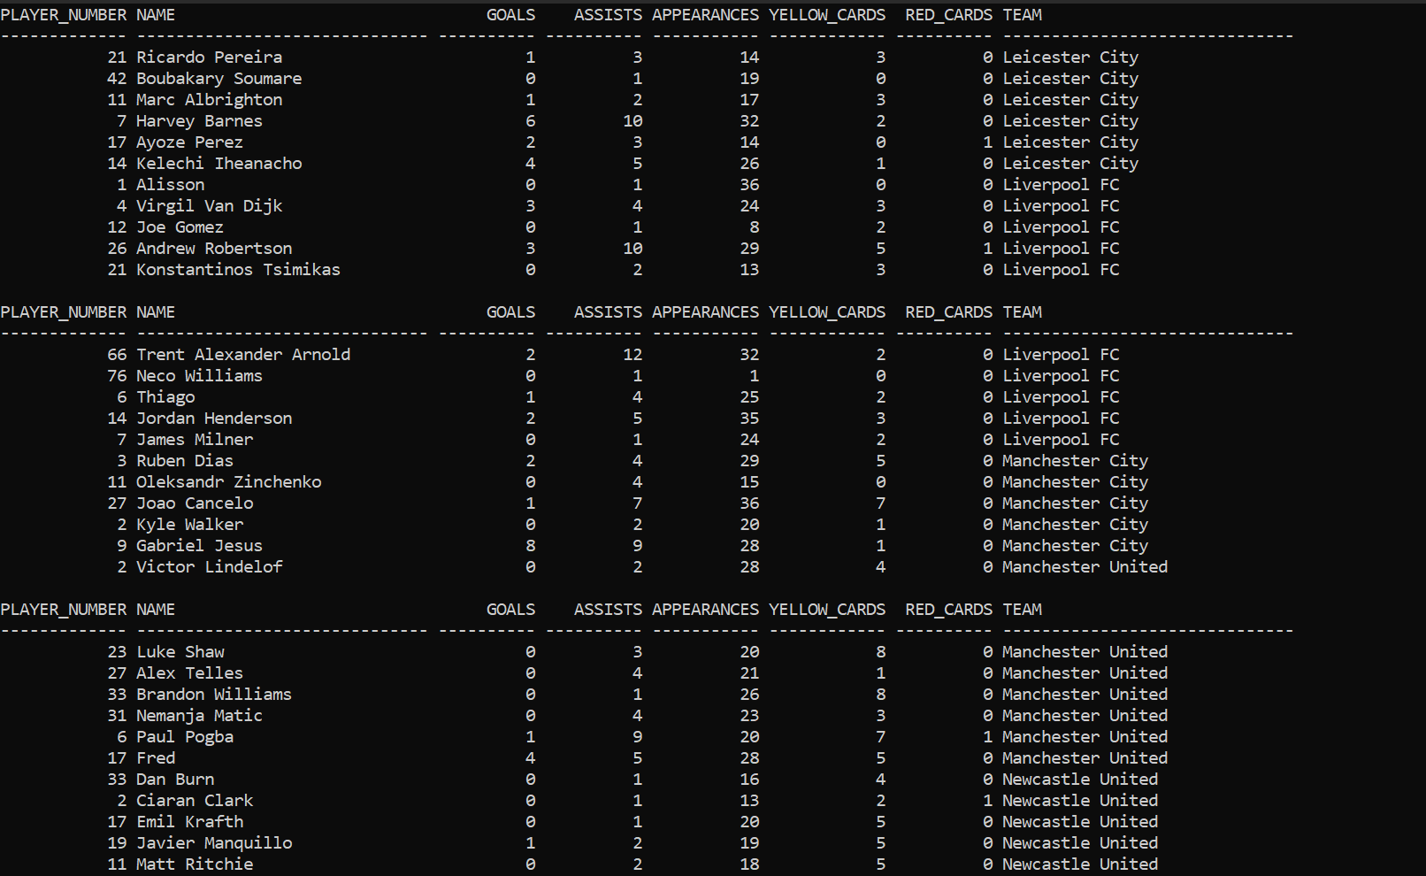
Players Who Have More Assists than Goals

Slide 8
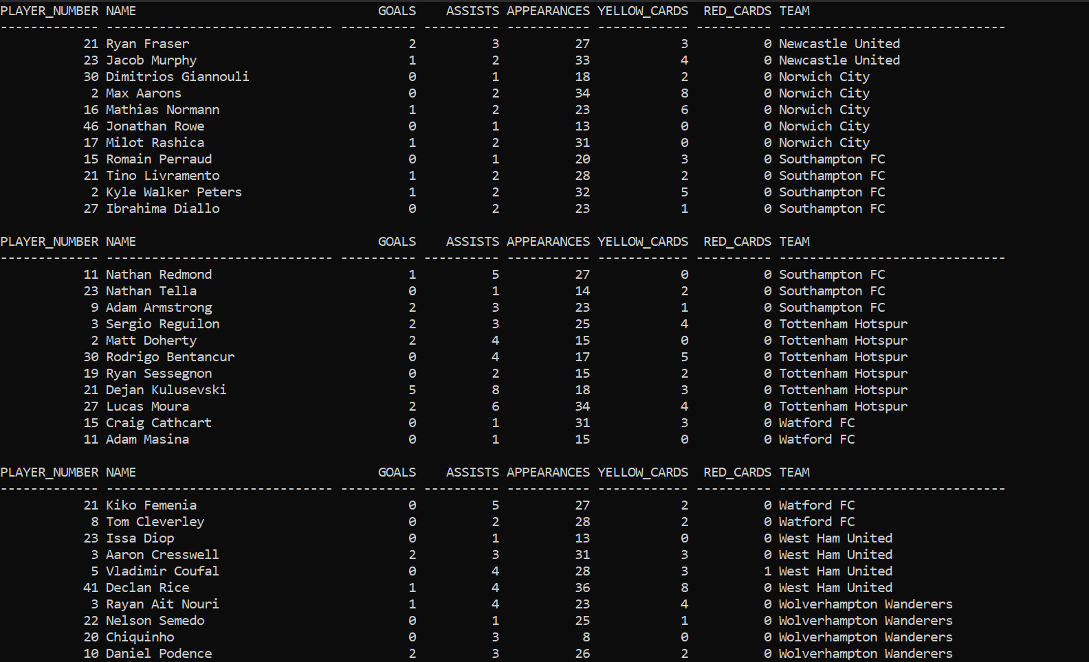
Players Who Have More Assists than Goals

Slide 9
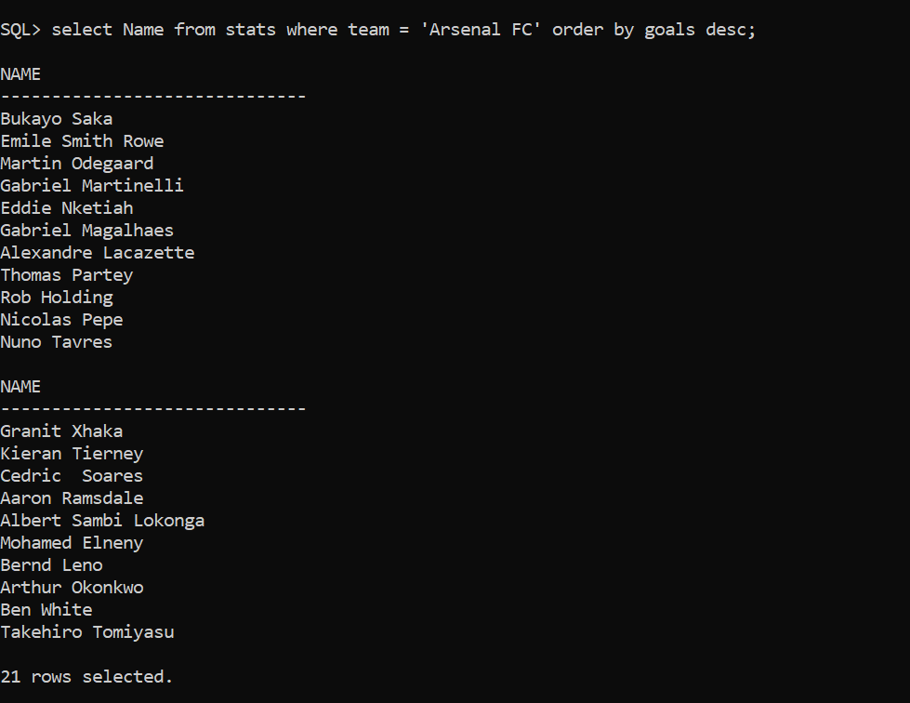
Players from A Club in Descending Order by Goals

Slide 10
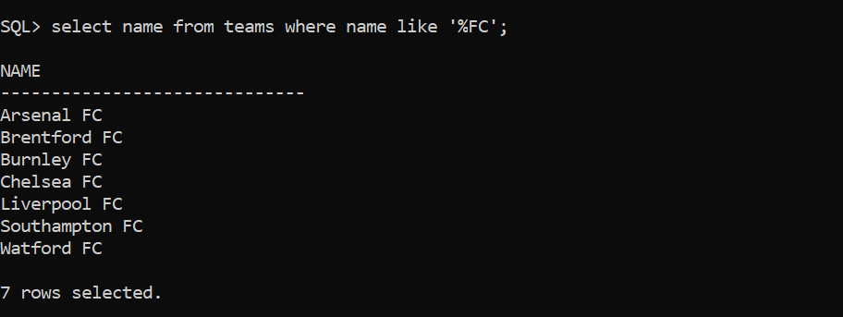
Teams Ending With FC

Slide 11
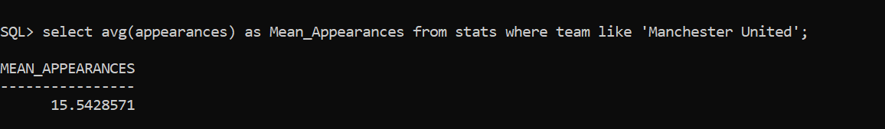
Average Matches Player By Manchester United Players

Slide 12
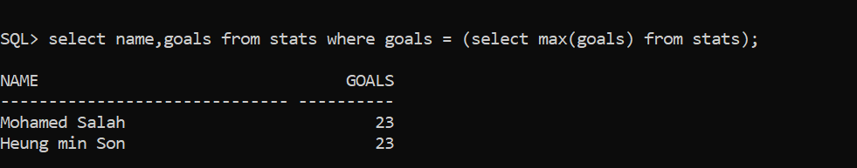
Selecting Max Goals Scored By Player

Slide 13
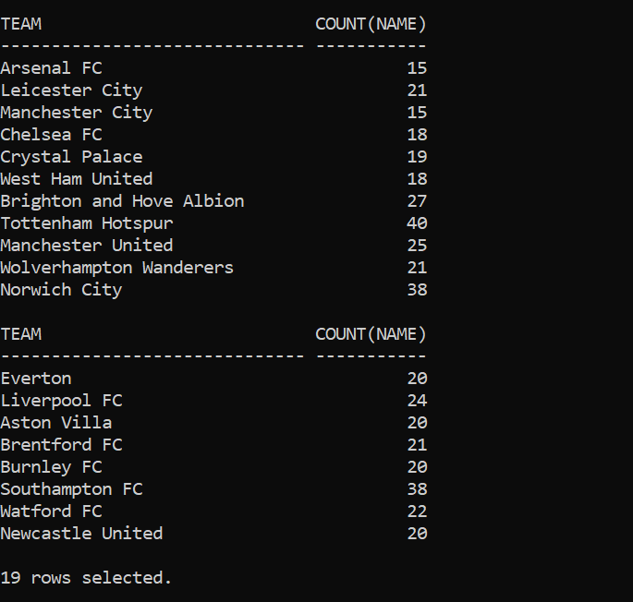
Counting Players In A Club

Slide 14
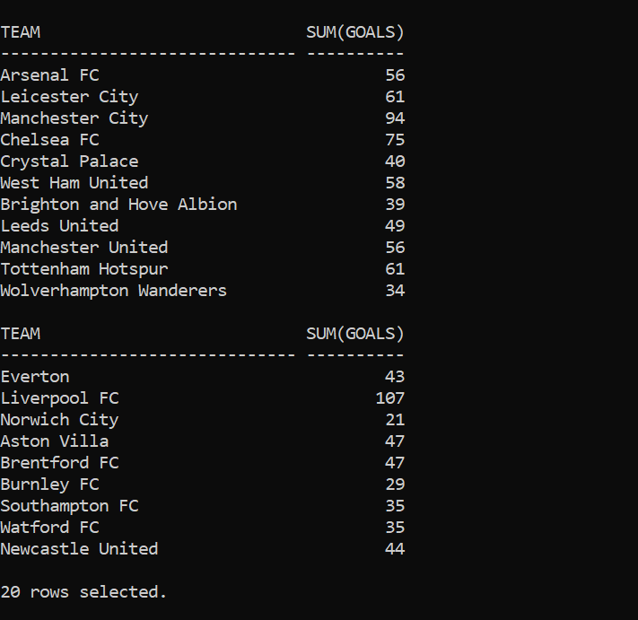
Goals Scored By Club

Slide 15
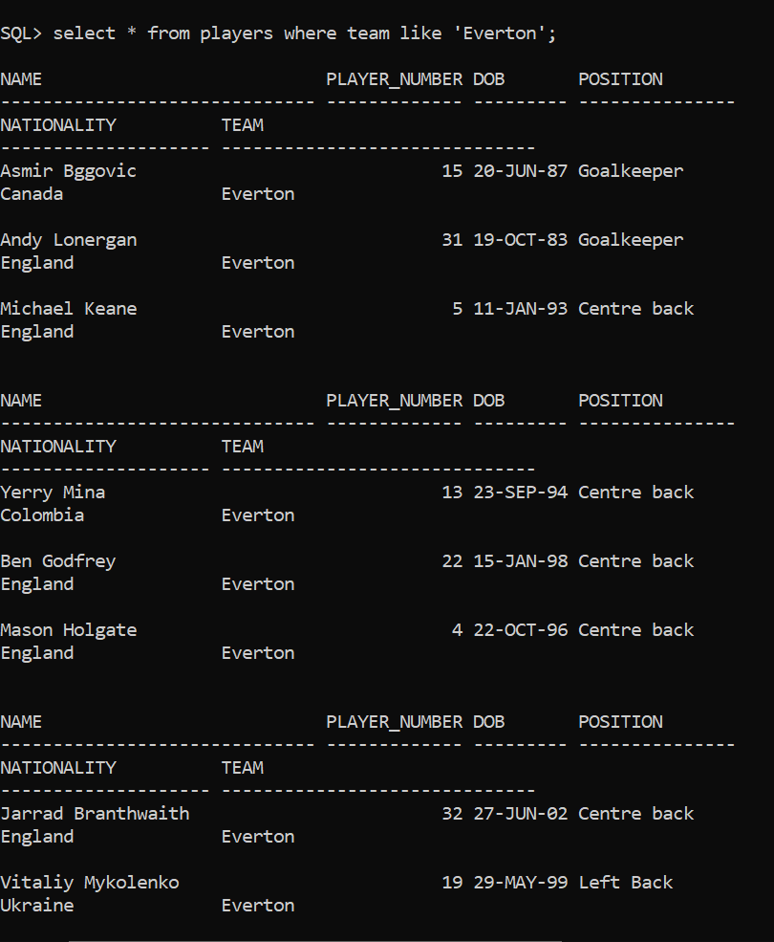
Players from a Team

Slide 16
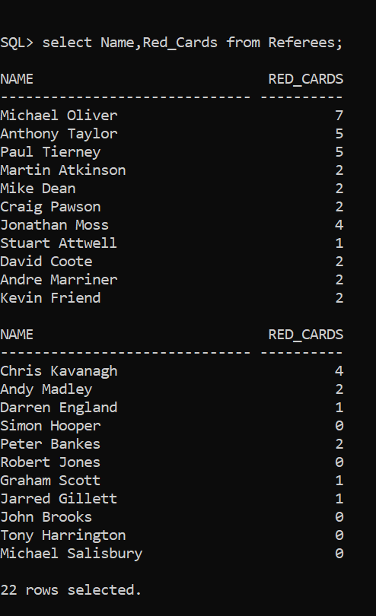
Name of Referees with Number Of Red Cards

Slide 17
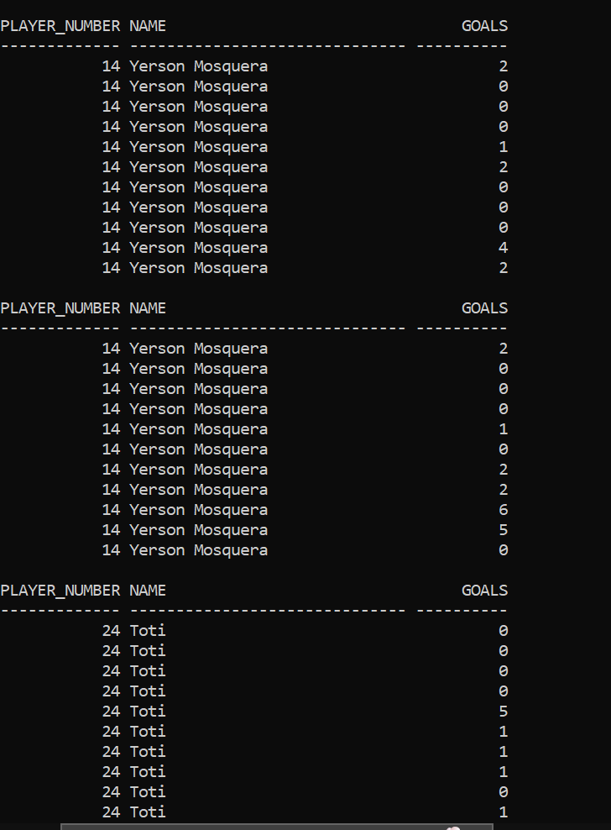
Players Name with Number and Goals

Slide 18
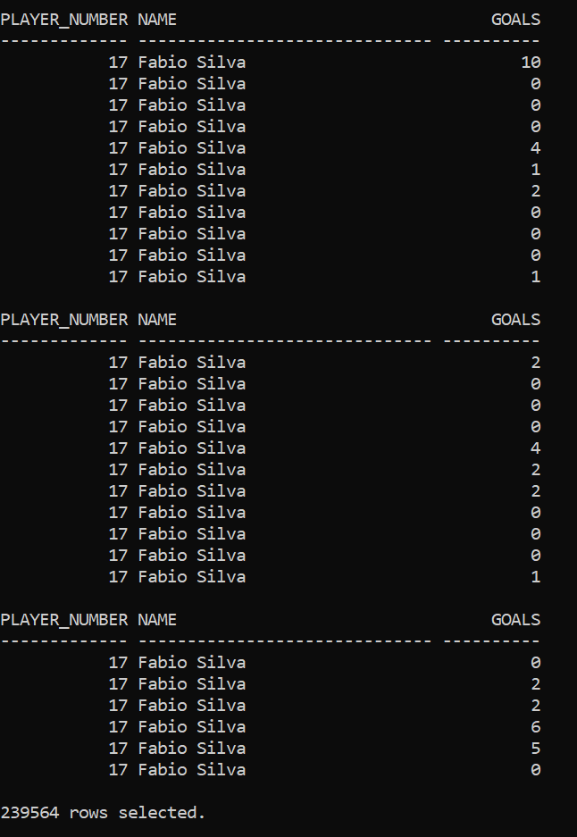

Slide 19
References –
https://www.javatpoint.com/dbms-relational-algebra
https://www.guru99.com/relational-algebra-dbms.html
https://www.w3schools.com/sql/default.asp
https://www.transfermarkt.co.in/premier-league/startseite/wettbewerb/GB1/plus/?saison_id=2021
https://stackoverflow.com/questions/10839856/using-sql-loader-in-oracle-to-import-csv-file

